Slide 1
CSCD 101/CSIT 103
Introduction to Computer Science
Lecture 4 –Computer Hardware Fundamentals
Lecturer: Prof. Ferdinand Katsriku, CSD
Contact Information: fkatsriku@ug.edu.gh

Slide 2
Lecture Overview
Hardware
Logic Gates and Logic Circuits
Processor Fundamentals
Assembly Language Programming

Slide 3
Topics
Hardware
  The Memory System
  Memory Components
  Secondary Storage Devices
  Peripheral Devices
Logic Gates and Logic Devices
  Boolean Logic and Problem Statements
  Boolean Operators
  Truth Tables
  Circuits and Gates

Slide 4
Topics
Processor Fundamentals
  Von Neuman Model
  CPU Architecture
  System Bus
  The Fetch Execute Cycle
Assembly Language Programming
  Machine Code Instructions
  Assembly language
  Addressing Modes
  Assembly Language Instructions

Slide 5
Hardware
The Memory System
Memory Components
Secondary Storage Devices
Peripheral Devices

Slide 6
Hardware
Objectives
  Show understanding of the need for primary storage
  Show understanding of the need for secondary (including removable) storage
  Identify hardware used for input, output, secondary storage
  Show understanding of the basic internal operations of specific types of devices

Slide 7
The memory System
Broadly there are two main uses of the computer
  To run programs
  To store data
Memory Hierarchy
Component
Register | Processor Component
Cache Memory | Primary Storage
Main Memory | Primary Storage
Hard disk | Secondary Storage
Auxiliary Storage | Secondary Storage
Access Time Capacity Size Cost
© Cambridge University Press 2016

Slide 8
Memory Components
The processor has direct access to three types of storage component:
  Registers
  Cache
  Main memory
Cache is use to store data that at any time is the most likely to be needed again by the processor
Primary Memory
© Cambridge University Press 2016

Slide 9
Memory Components
Random Access Memory (RAM)
  Volatile type of memory that can be read from or written to any number of times. Contents lost when power is off
  Better name for this is direct access memory (why?)
Read-Only Memory (ROM)
  This is non-volatile type of memory that cannot be written to but can be read from any number of times
© Cambridge University Press 2016
Notes:
Best to call call RAM Direct access memory

Slide 10
Memory Components
RAM Technologies
  Dynamic RAM (DRAM): made from capacitors. These leak stored charge and therefore need to be recharged very often in milliseconds
  Static RAM (SRAM): Made from flip flops. These can maintain their charge so long as the computer is switched on. Has shorter access time than DRAM.
  DRAM is cheap to make
  Has more capacity per chip
  Requires less power to operate
  Cache is built from SRAM and main memory from DRAM
© Cambridge University Press 2016
Notes:
Best to call call RAM Direct access memory

Slide 11
Memory Components
Why do memory hierarchies work?
Principle of locality of Reference
  Temporal locality
    Recently referenced items are likely to be referenced again in the near future
  Spatial locality
    Items with nearby addresses tend to be referenced close together in time
© Cambridge University Press 2016
Notes:
Best to call call RAM Direct access memory

Slide 12
  Peripheral Devices
Input
  Keyboard Mouse, trackerball, optical mouse
  Scanner, sensors, touchscreen, microphone
Output
  the monitor, printer, speakers
Secondary Storage

Slide 13
  Secondary Storage Devices
Device drivers
  Any device you connect to a computer requires some software to operate the device such software is called device driver
Magnetic Media
  Originally used in the music industry
  Magnetic tape cassette can be used for backup
  Magnetic disk normally the built-in storage
Optical media
  Optical disc media, several types, removable and portable
Solid-state can be the built-in storage but otherwise a peripheral device connected to a USB port

Slide 14
Hard Disk

Slide 15
Hard Disk
Has a number of rigid platters
The surface of the platter is made of ferrous oxide
Platters are mounted on a central spindle
The entire construction is contained in an aluminum casing
Each platter has a read/write head mounted on the arm
The surface of the platter is divided into concentric tracks
Tracks are divided into storage blocks- 512bytes

Slide 16
  Secondary Storage Devices

Slide 17
  Secondary Storage Devices

Slide 18
Disk Capacity
Capacity:
  Maximum number of bits that can be stored.
Units
  Gigabytes (GB); 1GB =10⁹ bytes
Factors that determine Capacity
  Recording Density
  Track density
  Areal density

Slide 19
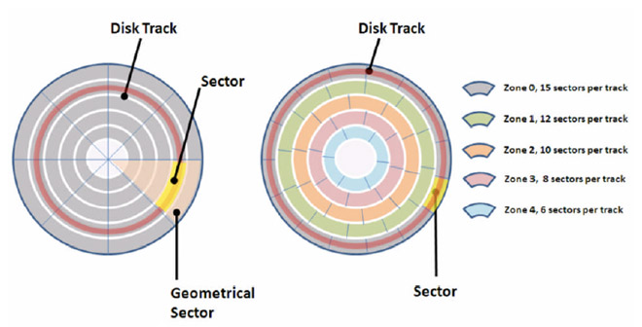
Recording Zones
Modern Disks partition tracks into disjoint subsets called recording zones
Each track in a zone has the same number of sectors, determined by the circumference of innermost track.

Slide 20
How to Calculate Disk Capacity
Capacity = Number of bytes/sector x average no. of sectors/track x no tracks per surface x no of surfaces/platter x no. of platters/disk
Example
512 bytes per sector
300 sectors per track on average
20,000 tracks per surface
2 surfaces per platter
5 platters per disk

Slide 21
Factors Affecting Disk Performance
Disk Access Time = Access Time + Data Transfer Time
  Access Time
  Seek Time
  Rotational Latency
  Command Processing Time
  Settle Time

Slide 22
Factors Affecting Disk Performance
Disk Access Time = Access Time + Data Transfer Time
Data Transfer Time:
Data Transfer Time is defined as the time required to transfer data between the system and the disk.
Data Transfer Time is of two types:
(a). Internal Transfer Rate
(b). External Transfer Rate

Slide 23
  Secondary Storage Devices
Can you find out what memory components are in the computer you are using and any details about them such as type and storage capacity
Carry out research into the technologies currently available for storage
Consider first the options available for storage device inside a laptop computer. Create a table showing cost, storage capacity and access speed for typical examples
Can you identify which technologies remain viable and which ones are becoming obsolete?

Slide 24
Logic Gates and Logic Devices
  Boolean Logic and Problem Statements
  Boolean Operators
  Truth Tables
  Circuits and Gates
Objectives
  Use logic gate symbols
  Understand and define the functions NOT, AND, OR, NAND, NOR and XOR (EOR)
  Construct truth tables
  Construct logic circuit from problem statement or logic expression
  Construct truth table form logic circuit or logic expression

Slide 25
Boolean Logic and Problem Statements
  Is Kumasi further north than Tamale?

Slide 26
Boolean Logic and Problem Statements
  Is Kumasi further north than Tamale?
  Yes or No

Slide 27
Boolean Logic and Problem Statements
  Is Kumasi further north than Tamale?
  Yes or No
  Kumasi is further north than Tamale

Slide 28
Boolean Logic and Problem Statements
  Is Kumasi further north than Tamale?
  Yes or No
  Kumasi is further north than Tamale
  TRUE or FALSE
  This is known as logic proposition
  A logic proposition is a statement that is either TRUE or FALSE

Slide 29
Boolean Logic and Problem Statements
  You should take an umbrella
  if it is raining
  or
  if the weather forecast is for rain later
  The air conditioning is set to come on in an office
  only during office hours
  but also
  only if the temperature rises above 25ºC
  Problem statement: An informal definition of an outcome which is dependent on one logic proposition or a combination of two or more logic propositions
Notes:
Each of these has two logic propositions which are combined in some way and finally there is an outcome which is dependent on the combination of the propositions
These are examples of problem statement

Slide 30
Boolean Logic and Problem Statements
  A logical proposition is any proposition that can be reduced by replacement of its constituent terms to a proposition expressing a logical truth
  “If p and q, then p.”
  Examples
  Ghana holds presidential elections every four years
  Adzoa bought a new car."

Slide 31
Boolean Operators
  Three basic operators
  AND OR NOT
  Definition for AND
  A AND B is TRUE if A is TRUE and B is TRUE
  A and B represent any logic proposition that has a TRUE or FALSE value
  Definition for OR
  A OR B is TRUE if A is TRUE or B is TRUE
  What if both A and B are true? What will be the result

Slide 32
Boolean Operators
  Take_umbrella = TRUE
  IF (raining = TRUE) OR (rain_forecast = TRUE)
  System_on = TRUE
  IF (office_hours =TRUE) AND (temperature > 25ºC)
  Logic Expression: Logic propositions combined using Boolean operators, which may be written with a defined outcome
Notes:
We call this logic expressions

Slide 33
Boolean Operators
  NOT A
    is TRUE if A is FALSE
  A AND B
    is TRUE if A is TRUE and B is TRUE
  A OR B
    is TRUE if A is TRUE or B is TRUE
Notes:
We call this logic expressions

Slide 34
Boolean Operators
  A NAND B
    is TRUE if A is FALSE or B is FALSE
  A NOR B
    is TRUE if A is FALSE and B is FALSE
  A XOR B
    is TRUE if A is TRUE or B is TRUE but not both of them
Notes:
We call this logic expressions

Slide 35
Truth Tables
  TRUE = 1
  FALSE = 0
A | B | X
0 | 0 | 0
0 | 1 | 0
1 | 0 | 0
1 | 1 | 1
Notes:
Powerful but simple technique for representing any logic expression

Slide 36
Logic Circuits and Gates
  The digital circuits represent the inner workings of a computer
  It operates on the basis that at any one time an individual part of the circuit can be in either ON or OFF state.

Slide 37
Logic Circuits and Gates
  The circuitry is made from billions of transistors
  The circuitry is made from logic gates
  Logic Gate: Is a component of of a logic circuit that has an operation which matches that of a Boolean operator

Slide 38

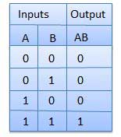
Logic Circuits and Gates
AND Gate
  A circuit which performs an AND operation.
  It has n input (n >= 2) and one output.
Logic diagram
Truth Table

Slide 39

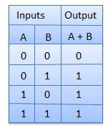
Logic Circuits and Gates
OR Gate
  A circuit which performs an OR operation.
  It has n input (n >= 2) and one output.
Logic diagram
Truth Table

Slide 40

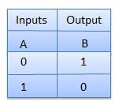
Logic Circuits and Gates
NOT Gate
  A circuit which performs an NOT operation.
  It has one input (n = 1) and one output.
Logic diagram
Truth Table

Slide 41

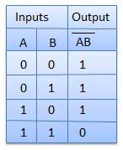
Logic Circuits and Gates
NAND Gate
  A NOT-AND operation is known as NAND operation. It has n input (n >= 2) and one output.
Logic diagram
Truth Table

Slide 42

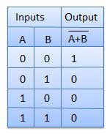
Logic Circuits and Gates
NOR Gate
  A NOT-OR operation is known as NOR operation. It has n input (n >= 2) and one output.
Logic diagram
Truth Table

Slide 43

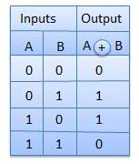
Logic Circuits and Gates
XOR Gate
  XOR or Ex-OR gate is a special type of gate. It can be used in the half adder, full adder and subtractor. It has n input (n >= 2) and one output.
Logic diagram
Truth Table

Slide 44

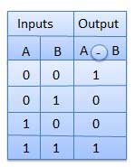
Logic Circuits and Gates
XNOR Gate
  XNOR gate is a special type of gate. It can be used in the half adder, full adder and subtractor. It has n input (n >= 2) and one output.
Logic diagram
Truth Table

Slide 45
Logic Circuits and Gates
Draw a circuit where A and B are input to an AND gate from which the output is carried to a NOT gate from which there is an output X. Show that this has the same outcome as having one NAND gate

Slide 46
Logic Circuits and Gates
Consider the following problem statement: A bank offers a special lending rate to customers subject to certain conditions. To qualify, a customer must satisfy certain criteria:
  The customer has to be with the bank for two years
  Two of the following conditions must also apply
    The customer is married
    The customer is aged 25 years or older
    The customer’s parents are also customers of the bank
Notes:
Construct a logic expression and a logic circuit to represent this problem

Slide 47
Logic Circuits and Gates
An oven has a number of components which should all be working properly. For each component there is a signaling mechanism that informs a management system if all is well or if there is a problem when the oven is being used. The table summarizes the signal values that record the status for each component (see next slide). If the thermometer reading is in range but either or both the fan and light are not working, the management system has to output a signal to activate a warning light on the control panel
Draw a logic circuit for this fault condition
Notes:
Draw a logic circuit to represent this fault condition

Slide 48
Logic Circuits and Gates
Signal | Value | Component condition
A | 0 | Fan not working
 | 1 | Fan working properly
B | 0 | Internal light not working
 | 1 | Internal light working properly
C | 0 | Thermometer reading too high
 | 1 | Thermometer reading in range
Notes:
Draw a logic circuit to represent this fault condition

Slide 49
Processor Fundamentals
Processor Fundamentals
  Von Neuman Model
  CPU Architecture
  System Bus
  The Fetch Execute Cycle

Slide 50
Processor Fundamentals
Objectives
  Show understanding of von Neumann Model
  Show understanding of role carried out by registers
  Show understanding of role of ALU and control unit
  Show understanding of the bus system
  Describe the fetch execute cycle

Slide 51
Von Neuman Model
Features
  There is a processor, a central processing unit
  The processor has direct access to a memory
  The memory contains a ‘stored program’ and the data required by the program
  The stored program consists of individual instructions
  The processor executes instructions sequentially
Notes:
This is the simplest form of what might be described as computer system or model of a computer.
Credited to John von Neumann because he was the first to describe the basic principles in a publication

Slide 52
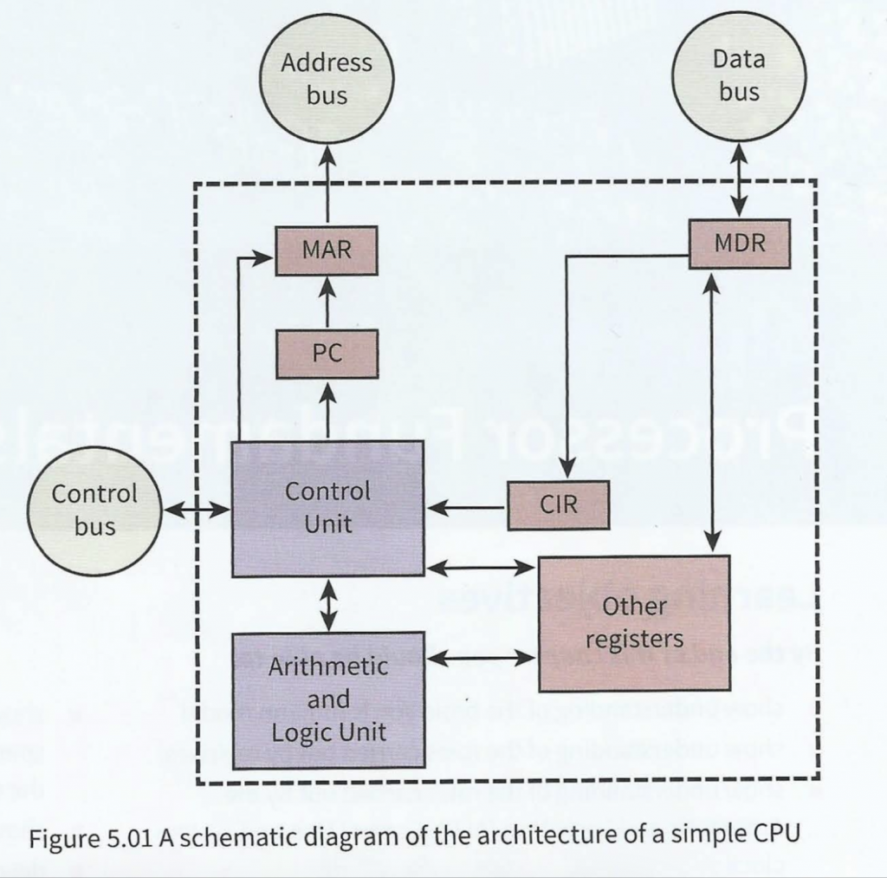
CPU Architecture

Slide 53
CPU Architecture
Notes:
MAR memory address register – stores the address of a memory location which is about to have a value read from or written to
MDR memory data register – stores data that has just been read from memory or is just about to be written to memory
IR instructions register – stores the current instruction while it is being decoded and executed
PC program counter – stores the address of where the next instruction is to be read
SR status – register contains individual bits that are either set or cleared

Slide 54
CPU Architecture
Program: a sequence of instructions stored in memory and the data he program will process
Arithmetic and Logic Unit (ALU): performs calculations on data
Control Unit: processes and executes instructions held in main memory

Slide 55
CPU Architecture
Registers: the smallest unit of storage on the microprocessor.
Transfer of data between registers or between register and memory cell is very fast
Two categories of registers
  General purpose registers (typically 8)
    Can normally be used by the programmer
  Special purpose registers

Slide 56
CPU Architecture
Registers:
Accumulator: a general purpose register that stores a value before and after the execution of an instruction by ALU
Program Counter (PC): stores the address of where the next instruction is to be read from
Memory Data Register (MDR): stores data that has just been read from memory of is just about to be written to memory

Slide 57
CPU Architecture
Registers:
Memory Address Register (MAR): stores the address of a memory location which is about to be read from or written to.
Index address Register(IR): stores a value which will be used to change an address
Current Instruction Register (CIR): stores the current instructions whilst it is being decoded and executed

Slide 58
CPU Architecture
Registers:
Status Register(SR):contains individual bits that are either set or cleared.
  Carry bit
  Zero
  Negative
  overflow

Slide 59
System Bus
A bus is a parallel transmission system component with each separate wire carrying a single bit
A bus is not a storage device and does not hold data
It is a mechanism for the transfer of data from one component to another

Slide 60
System Bus

Slide 61
System Bus
The address bus
  A component that carries an address to the memory controller to identify a location in memory which is to be read from or written to.
  The address is loaded on to the bus from the MAR when directed by the CU

Slide 62
System Bus
The address bus
  It is only used to send address to a memory controller
  Bus width: number of separate wires in the bus. This defines the number of bits in the binary code of the address. Can vary from 16

Slide 63
System Bus
The data bus
Function of the data bus is to carry data
  Instructions
  Address
  Value
  Data is carried from CPU to memory

Slide 64
System Bus
The data bus
Function of the data bus is to carry data
  Memory to CPU
  It could also be carrying from I/O devices
  Bus width is important as it determines how much is carried at a go. Linked to word length

Slide 65
System Bus
Control bus
A bidirectional bus which transfers a signal from the control unit to any other system component.
Normally has a width of 8 wires
  Read operation completed
  Reset
  A memory write operation completed
  An I/O operation completed
  An interrupt has been received

Slide 66
Fetch Execute Cycle
START
Tranfer control to interrupt handling program
Any instructions to execute?
yes
No
Any interrupts ?
Execute instruction
yes
No
Fetch next instruction
Decode instruction

Slide 67
Fetch Execute Cycle
Step | Fetch execute cycle steps | Simplified description
1 | The PC contains the address of the memory location that has the next instruction which has to be fetched | PC has address of next instruction
2 | This address is then copied from the PC to the MAR via the address bus | PC copied to the MAR
3 | The contents (instruction) at the memory location (address) contained in MAR are then copied into the MDR | Lookup MAR and get contents. Copy contents into the MDR
4 | The contents (instruction) in the MDR is then copied and placed into the CIR | Copy MDR contents into the CIR
5 | The value in the PC is then incremented by 1 so that it now points to the next instruction which has to be fetched | PC is then incremented by 1
6 | The instruction is finally decoded and then executed by sending out signals (via control bus) to the various components of the computer | The instruction is decoded and then executed
7 | Repeat

Slide 68
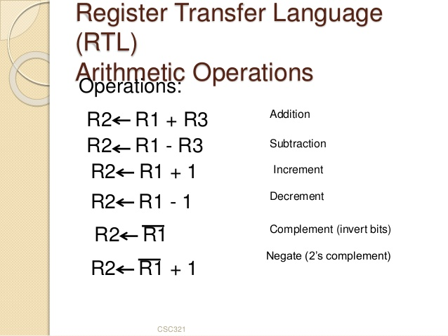
Register transfer notation

Slide 69
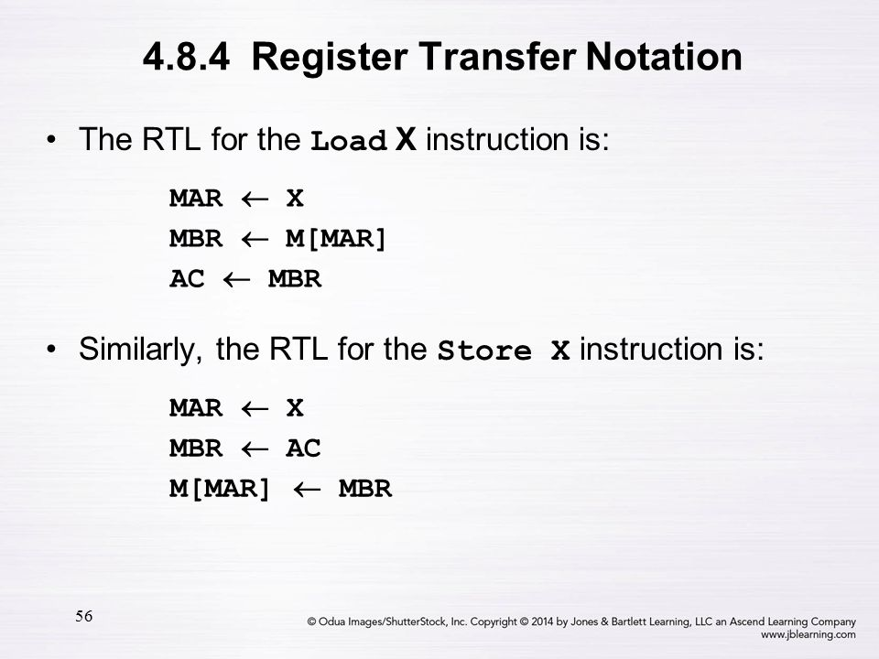
Register transfer notation

Slide 70
Topics
Processor Fundamentals
  Von Neuman Model
  CPU Architecture
  System Bus
  The Fetch Execute Cycle
Assembly Language Programming
  Machine Code Instructions
  Assembly language
  Addressing Modes
  Assembly Language Instructions

Slide 71
Questions

Slide 72
END
Thank you
Notes:
I hope you have enjoyed the session. In the next session we will begin to look are the whole concept of projects and how to manage them

